Slide 1
Wayne HealthCare
6411400
Greenville, OH
Annual Report
2018
Updated March 2018

Slide 2
Cancer Quality Improvement Program (CQIP)
A data-driven, process and outcomes-based cancer quality improvement initiative
Confidentially reports to 1,500 individual CoC-accredited hospitals their data as entered in NCDB (including comparisons with national data from all CoC-accredited programs)
PDF download provides information to support the reports, technical details, report creation, and scientific justification and references for quality measures
2017 release provides CoC-accredited facilities with data on:
Compliance with CoC-adopted quality measures
Volume data for complex surgical oncology operations with 30-day and 90 day mortality
Unadjusted and risk-adjusted survival data for selected cancer sites
Other clinical data and administrative data, which will be updated and expanded annually

Slide 3
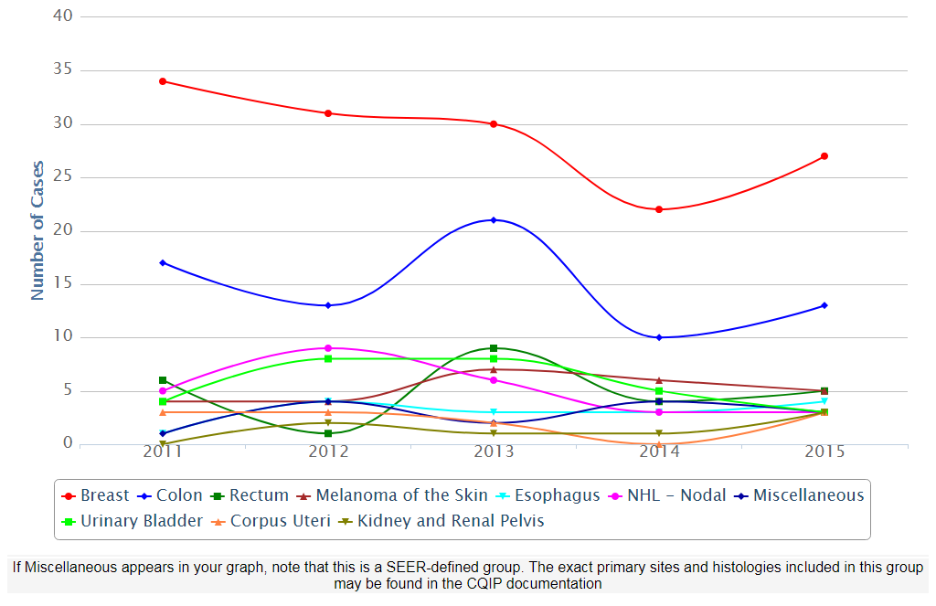
Cancer Program Total Case Volume, 2011 - 2015 My Facility

Slide 4
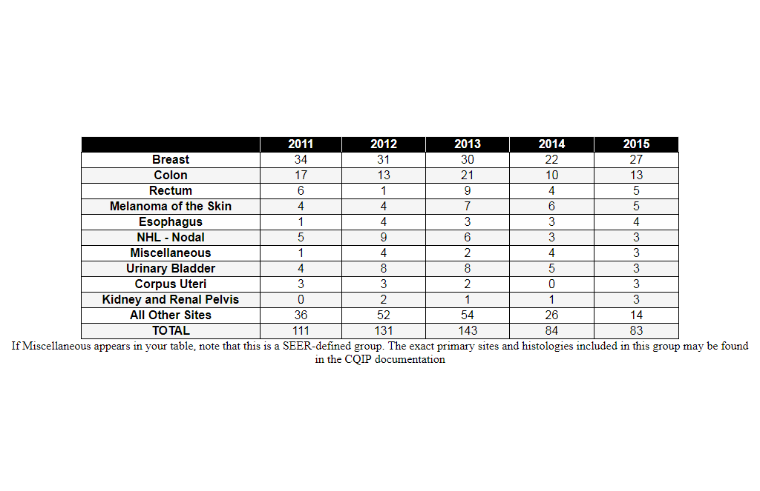
Cancer Program Total Case Volume, 2011 - 2015 My Facility

Slide 5
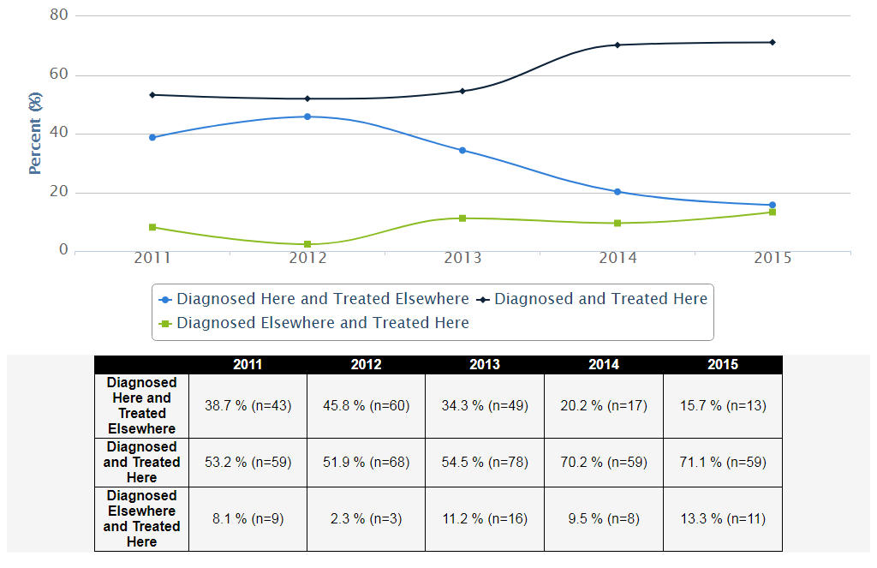
Total In/Out Migration, 2011 - 2015 - My Facility

Slide 6
Quality Measure Reports
Accountability Measure
Considered the current standard of care based on clinical trial evidence Commission on Cancer Standard 4.4.
Quality Improvement Measure (QI)
Demonstrates good practice based on consensus. Usually not based on clinical trial evidence. Commission on Cancer Standard 4.5 addresses compliance with quality improvement.
Surveillance Measure
Used at the community, regional, and/or national level to monitor patterns and trends of care in order to guide policymaking and resource allocation.

Slide 7
Quality Measure Reports – Breast
BCSRT: Breast radiation after breast conserving surgery (NQF 0219 – Accountability)
MAC: Combination chemotherapy for hormone receptor negative breast cancer (NQF 0559 – Accountability)
HT: Adjuvant hormonal therapy for hormone receptor positive breast cancer (NQF 0220 – Accountability)
BCS: Breast conserving surgery rate (Surveillance)
MASRT: Radiation therapy recommended or administered following mastectomy within 1 year of diagnosis for women with 4 or more positive regional lymph nodes (Accountability)
nBx: Image or palpation-guided needle biopsy (core or FNA) is performed for the diagnosis of breast cancer (Quality Improvement)
NQF = National Quality Forum Endorsed Measure

Slide 8
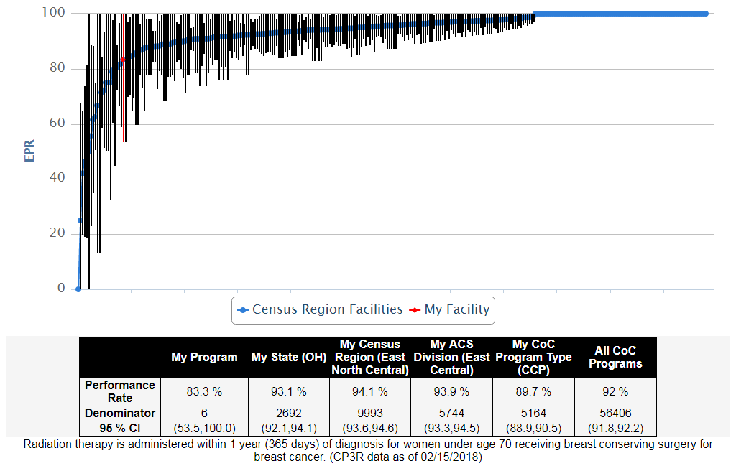
BREAST, 2015, BCSRT: Breast radiation after breast conserving surgery (NQF 0219 - Accountability)

Slide 9
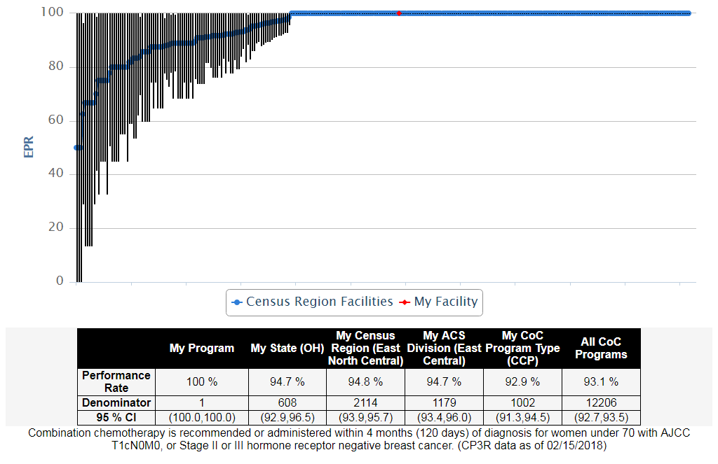
BREAST, 2015, MAC: Combination chemotherapy for hormone receptor negative breast cancer (NQF 0559 - Accountability)

Slide 10
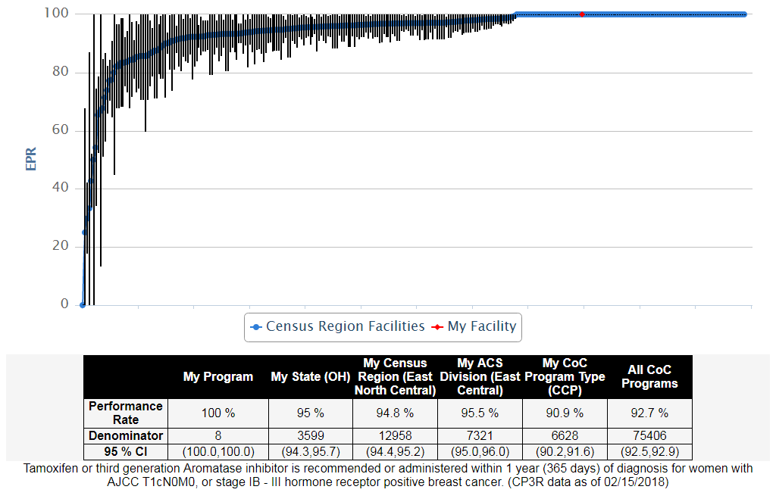
BREAST, 2015, HT: Adjuvant hormonal therapy for hormone receptor positive breast cancer (NQF 0220 - Accountability)

Slide 11
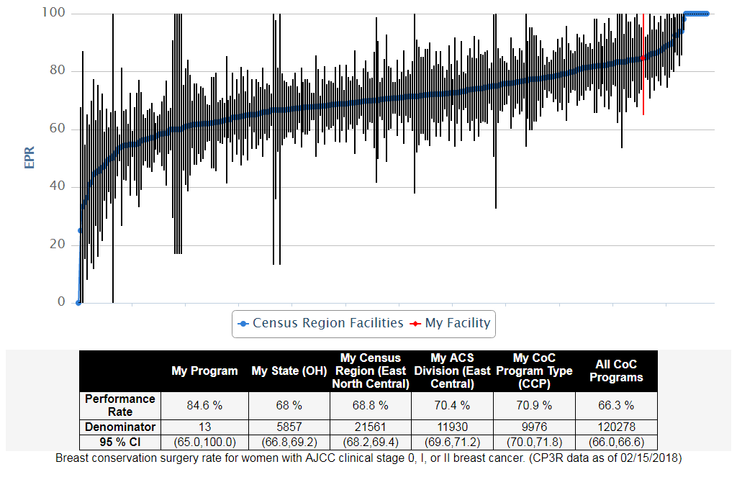
BREAST, 2015, BCS: Breast conserving surgery rate (Surveillance)
The national percentage of women having
breast conservation is 66.3%. In our facility, 84.6% had breast conservation.

Slide 12
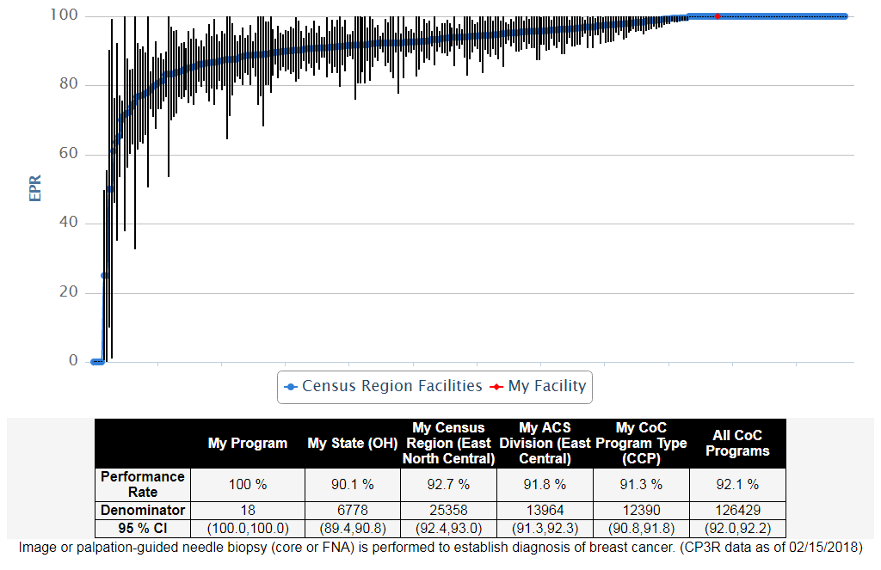
BREAST, 2015, nBx: Image or palpation-guided needle biopsy (core or FNA) is performed for the diagnosis of breast cancer (Quality Improvement)
Initial diagnosis of breast cancer by needle biopsy is preferred for
many reasons. 100% of our patients in 2015 were diagnosed by
needle biopsy.

Slide 13
Quality Measure Reports - Colon
ACT: Adjuvant chemotherapy for lymph node positive colon cancer (NQF 0223 – Accountability)
12RLN: At least 12 lymph nodes are removed and examined as part of primary colon cancer resection (NQF 0225 – Quality Improvement)
NQF = National Quality Forum Endorsed Measure

Slide 14
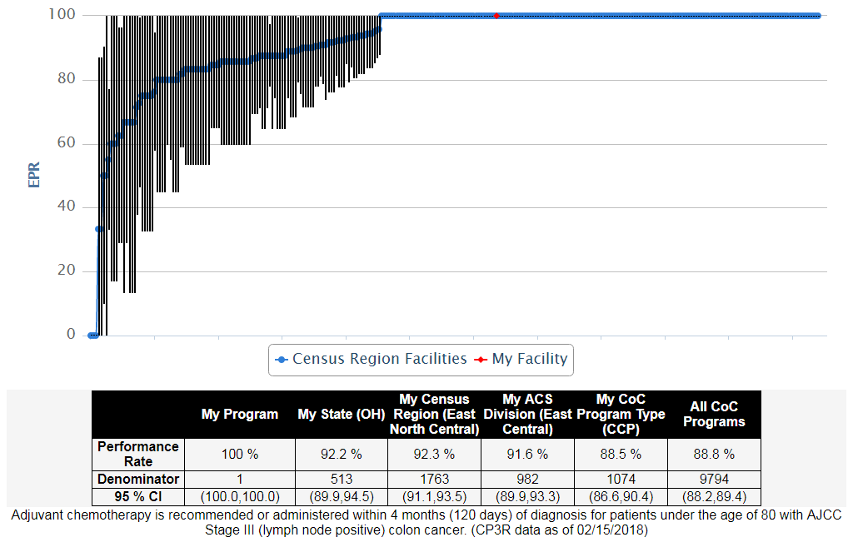
COLON, 2015, ACT: Adjuvant chemotherapy for lymph node positive colon cancer (NQF 0223 - Accountability)

Slide 15
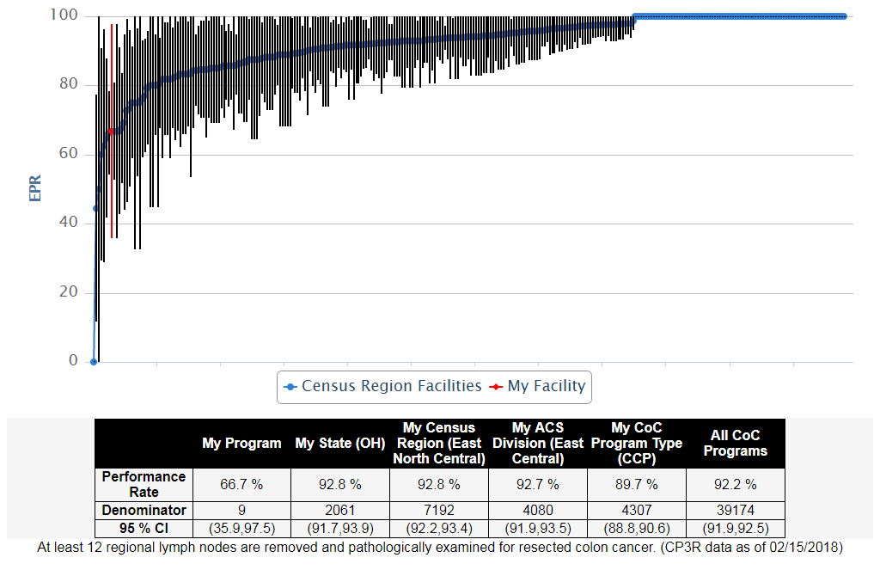
COLON, 2015, 12RL: At least 12 regional lymph nodes removed and pathologically examined for resected colon cancer (NQF 0225 - Quality Improvement)

Slide 16
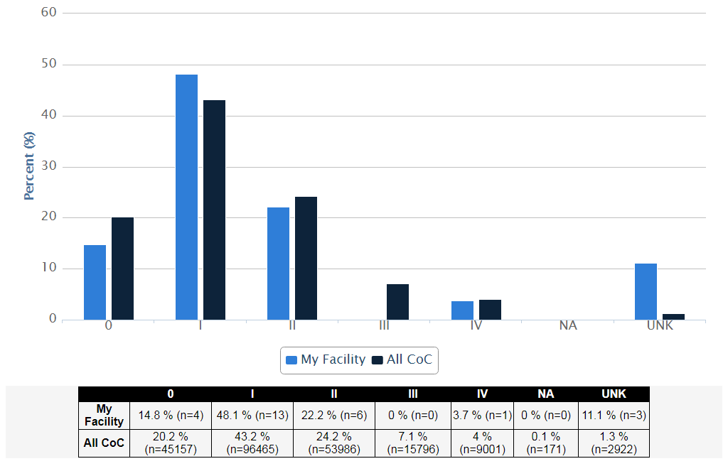
Stage Distribution - Breast Cancer Diagnosed in 2015, My Facility vs. All CoC

Slide 17
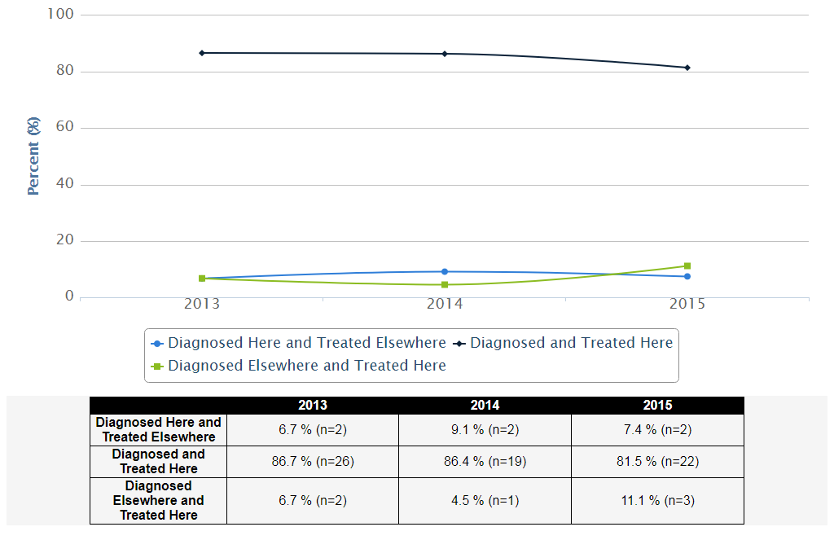
In/Out Migration Breast Cancer, 2013 - 2015 - My Facility

Slide 18
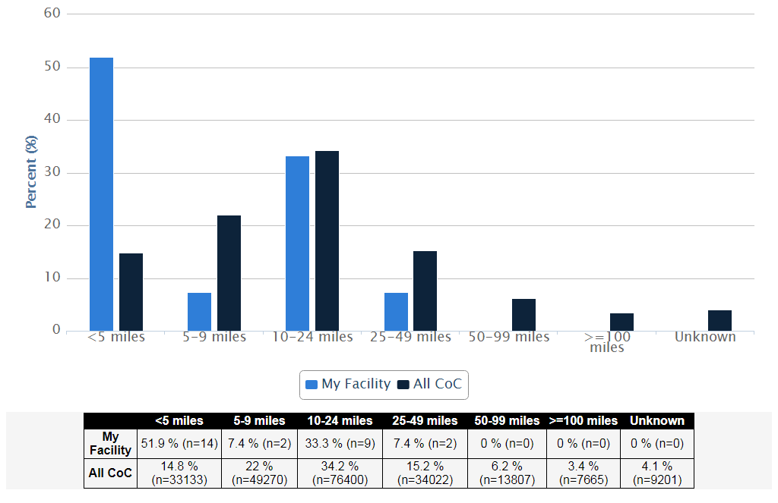
Distance Traveled - Breast Cancer, 2015 - My Facility

Slide 19
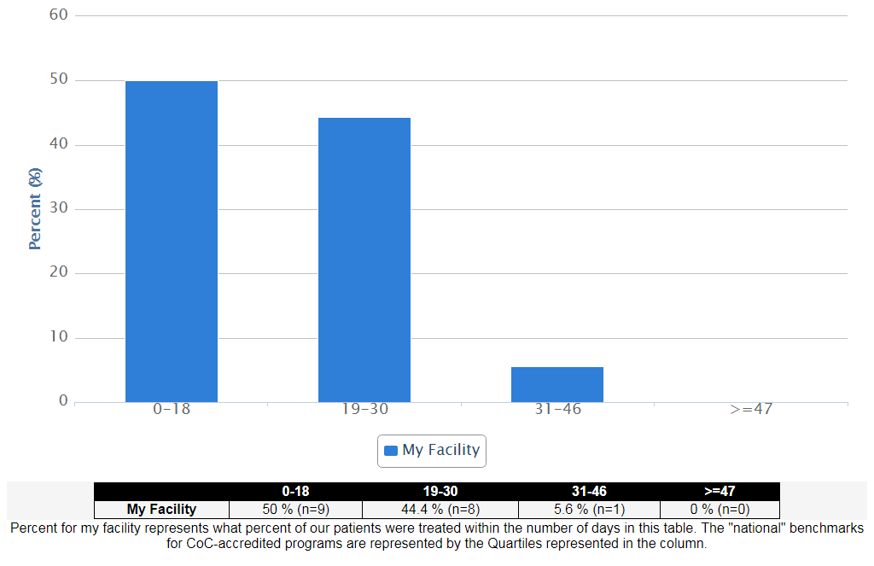
Days to First Treatment Quartiles Breast Cancer: Cases Diagnosed at My Facility or Elsewhere; Treated at My Facility, 2015

Slide 20
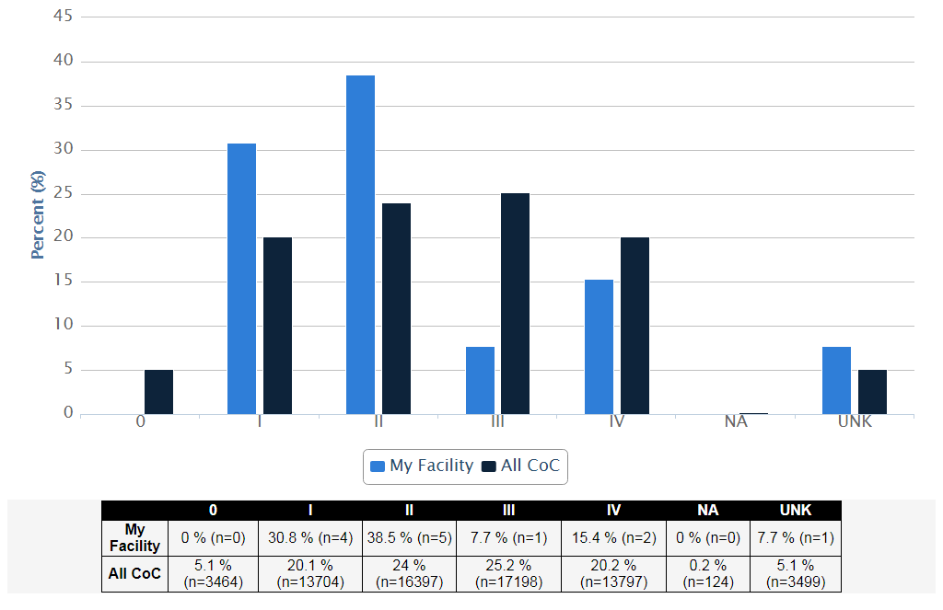
Stage Distribution - Colon Cancer Diagnosed in 2015, My Facility vs. All CoC

Slide 21
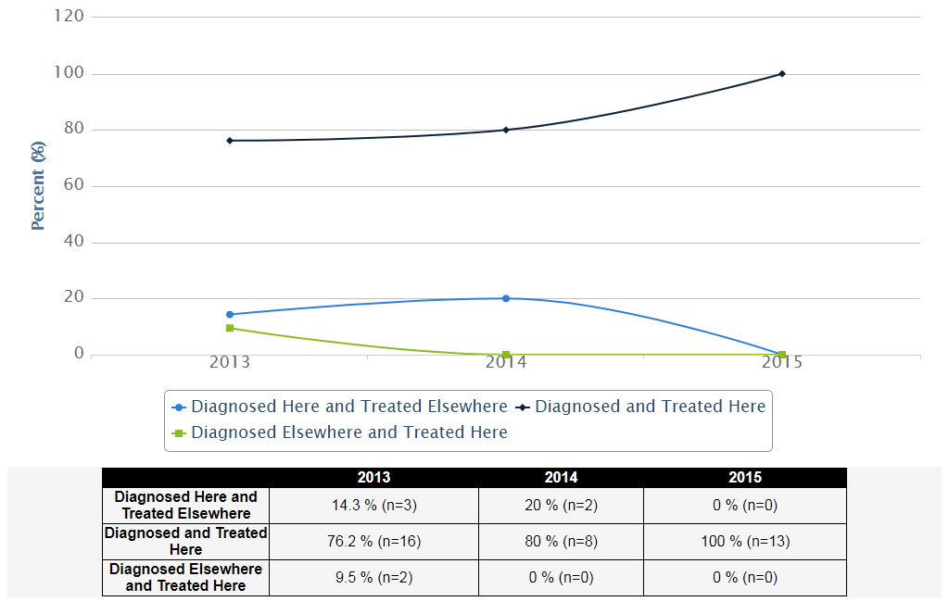
In/Out Migration Colon Cancer, 2013 - 2015 - My Facility

Slide 22
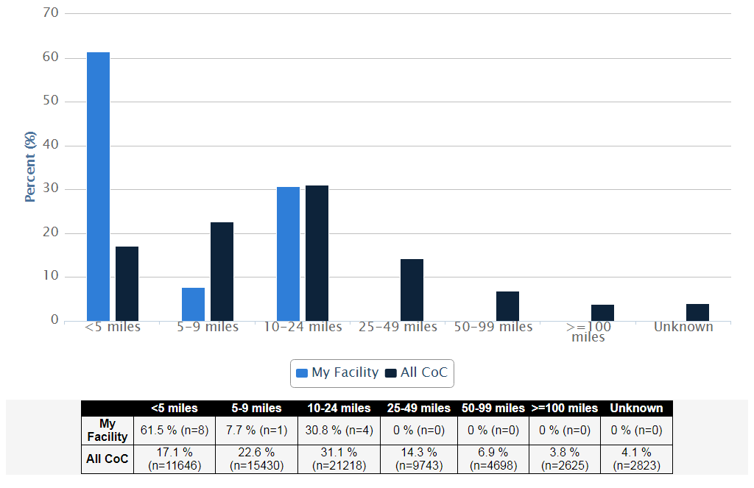
Distance Traveled - Colon Cancer, 2015 - My Facility

Slide 23
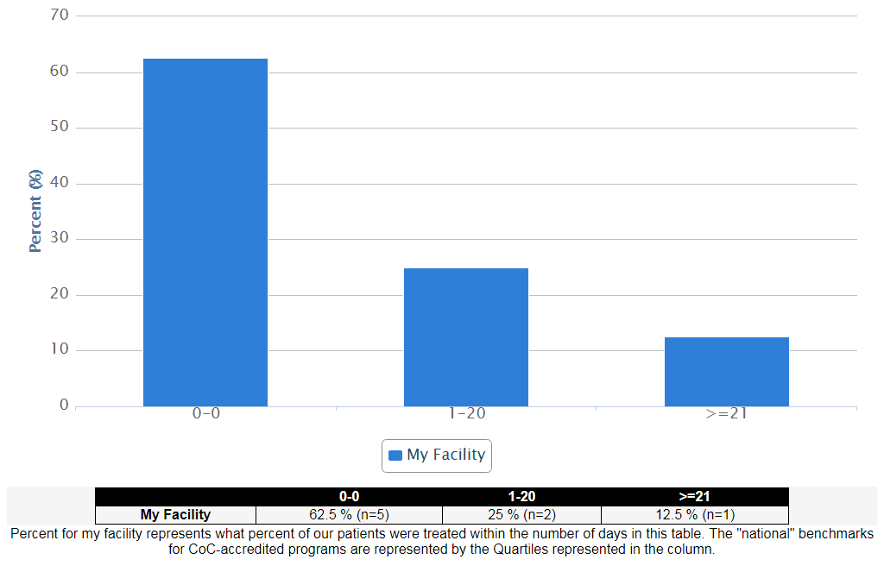
Days to First Treatment Quartiles Colon Cancer: Cases Diagnosed at My Facility or Elsewhere; Treated at My Facility, 2015

Slide 24
Commission on Cancer
Established by the American College of Surgeons (ACoS) in 1922
A consortium of professional organizations dedicated to improving survival and quality of life for cancer patients
Sets standards to ensure quality, multidisciplinary, and comprehensive cancer care delivery in health care settings
Conducts surveys to assess compliance with those standards
Collects standardized data to measure cancer care quality
Uses data to monitor treatment patterns and outcomes and enhance cancer control and clinical surveillance activities
Develops educational interventions to improve cancer prevention, early detection, cancer-care delivery, and outcomes

Slide 25
Commission on Cancer: The Value of Accreditation
Demonstrates commitment to patients, communities, providers, payers, and policymakers to improving survival and quality of life for patients and to evidence-based, organized, comprehensive, and quality cancer care
Standards ensure that state-of-the-art clinical services for diagnosing, treating, rehabilitating, and supporting cancer patients and their families are available to provide quality care
National Cancer Data Base participation by cancer registries captures more than 100 data elements for every patient and more than 70% of all new cancer patients diagnosed in the U.S. each year. Participant User File (PUF) access for research is only available to investigators at CoC-approved programs
Measuring quality and outcomes, including overall survival, through a rapidly expanding panel of quality measures for cancers of the breast, colon, rectum, lung, esophagus, and stomach, and soon to include gynecologic and urologic malignancies, melanoma, sarcoma and pediatric tumors. Comparison with nation-wide data from all 1,500 CoC-accredited programs
Ensures a multidisciplinary team approach including information and access to clinical trials, access to prevention and early detection programs, cancer conferences, and oversight by a Cancer Committee

Slide 26
Commission on Cancer - Accredited Programs By State

Slide 27
Commission on Cancer Member Organizations
Administrative Association of Cancer Executives (ACE) Association of Community Cancer Centers (ACCC) American Hospital Association (AHA) Community Oncology Alliance (COA) National Consortium of Breast Centers (NCBC)
Advocacy/Patient Based
American Cancer Society, Inc. (ACS) Cancer Support Community (CSC) LIVESTRONG (Livestrong Foundation) National Coalition for Cancer Survivorship (NCCS)
Allied Health Academy of Nutrition and Dietetics, Oncology Nutrition Group (AND) Academy of Oncology Nurse and Patient Navigators (AONN+) American Physical Therapy Association (APTA) American Psychosocial Oncology Society (APOS) Association of Oncology Social Work (AOSW) Association of Pediatric Oncology Social Workers (APOSW) National Society of Genetic Counselors (NSGC)
Clinical American Academy of Hospice and Palliative Medicine (AAHPM) American Academy of Pediatrics (AAP) American College of Medical Genetics and Genomics (ACMG) American College of Obstetricians and Gynecologists (ACOG) American College of Physicians (ACP) American College of Radiology (ACR) American Head and Neck Society (AHNS) American Medical Association (AMA) American Pediatric Surgical Association (APSA) American Radium Society (ARS) American Society for Radiation Oncology (ASTRO) American Society of Breast Surgeons (ASBS) American Society of Clinical Oncology (ASCO) American Society of Colon and Rectal Surgeons (ASCRS) American Society of Plastic Surgeons (ASPS) American Urological Association (AUA) College of American Pathologists (CAP) Hematology/Oncology Pharmacy Association (HOPA) Oncology Nursing Society (ONS) Resident and Associate Society American College of Surgeons (RASACS) Society for Immunotherapy of Cancer (SITC) Society of Gynecologic Oncology (SGO) Society of Nuclear Medicine and Molecular Imaging (SNMMI) Society of Surgical Oncology (SSO) Society of Thoracic Surgeons (STS) Young Fellows Association American College of Surgeons (YFAACS)

Slide 28
Commission on Cancer Member Organizations
Government Centers for Disease Control and Prevention (CDC) Department of Defense Military Health System (DOD) Department of Veterans Affairs/Veterans Health (VA) National Cancer Institute Healthcare Delivery Research Program (NCI HDRP) National Cancer Institute Surveillance, Epidemiology, and End Results Program (NCI SEER) Registry National Cancer Registrars Association, Inc. (NCRA) North American Association of Central Cancer Registries (NAACCR) Research/Education Alliance Clinical Research Program (ALLIANCE) American Association for Cancer Education (AACE) American Joint Committee on Cancer (AJCC) Association of American Cancer Institutes (AACI) National Accreditation Program for Breast Centers (NAPBC) National Comprehensive Cancer Network (NCCN) National Surgical Adjuvant Breast and Bowel Project (NSABP)

Slide 29
National Cancer Data Base (NCDB)
A joint program of the CoC and the American Cancer Society that began in 1988
A nationwide oncology database for more than 1,500 CoC-accredited U.S. cancer programs
70 percent of all newly diagnosed U.S. cancer cases are captured at the facility level and reported
Contains approximately 37 million records from hospital cancer registries across the U.S.

Slide 30
American College of Surgeons: 100+ Years of Quality Improvement

Slide 31
The American College of Surgeons and The American Cancer Society
Partners to Improve the Lives of Cancer Patients
The American Cancer Society funds the American College of Surgeons development of an approval program for cancer care clinic
1926
The American Cancer Society funds the Cancer Physician Liaison programs to engage physicians in Commission on Cancer accredited programs
1963
The American College of Surgeons and the American Cancer Society start the second century of their partnership
2013
1913
Overlapping groups of physicians found both the American College of Surgeons and the American Cancer Society
1959
The American Cancer Society and the American College of Surgeons are the founding members of the American Joint Committee on Cancer to formulate and publish cancer classification systems and staging
1988
The American College of Surgeons pilots the National Cancer Data Base, the largest repository of cancer patient data in the world
The Commission on Cancer acknowledges the support of the American Cancer Society
for their support of the National Cancer Data Base and
the Cancer Liaison Physician Program

Slide 32
Acknowledgements
American College of Surgeons
Commission on Cancer
Lawrence N. Shulman, MD, FACP, Chair
David P. Winchester, MD, FACS, Medical Director, Cancer Programs
CQIP
Matthew Facktor, MD, FACS, CQIP Project Director
Kenneth Pristas, CQIP Project Manager, MSHI, PMP
Commission on Cancer
Committee Leadership
CQIP/NCDB Staff
Ryan McCabe Ph.D
Amanda Browner, MS
Greer Gay, Ph.D, RN
Natalie Goodwin, MS
Katherine Mallin, Ph.D
Bryan Palis, MA
Florin Petrescu, MS
Kenneth Pristas, MSHI, PMP
Accreditation
Danny M. Takanishi, Jr., MD, FACS, Chair
Bruce Averbook, MD, FACS, Vice-Chair
Advocacy
Alan G. Thorson, MD, FACS, Chair
Michael S. Bouton, MD, MA, FACS, Vice-Chair
Cancer Liaison
Mary J. Milroy, MD, FACS, Chair
Peter S. Hopewood, MD, FACS, Vice-Chair
Education
Hisakazu Hoshi, MD, FACS, Chair
Laurie Kirstein, MD, FACS, Vice-Chair
Further Assistance
Kenneth Pristas, MSHI, PMP
IT Manager, NCDB
Phone: 312-202-5451
Email: kpristas@facs.org
Member Organizations
Carma S. Herring, RN, MSN, OCN, Chair
Peter T. Hetzler, MD, FACS, Vice-Chair
Nominating Committee
Daniel P. McKellar, MD, FACS, Chair
CQIP Email
ncdbcqip@facs.org
Quality Integration
Matthew Facktor, MD, FACS, Chair
Ted James, MD, FACS, Vice-Chair

Slide 33
Commission on Cancer
www.facs.org/quality-programs/cancer/coc
312-202-5085
CQIP
www.facs.org/quality-programs/cancer/ncdb/qualitytools/cqip

